Slide 1
Chindogu
Dummeste og grimmeste app

Slide 2
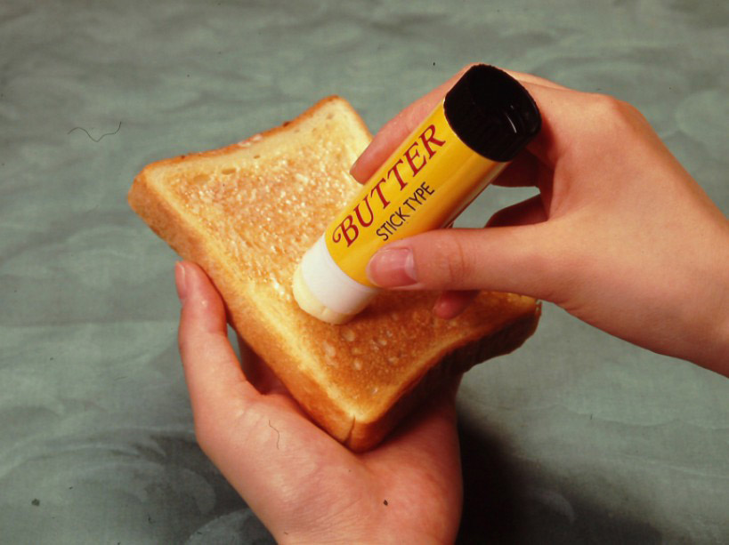
Chindogu
Chindogu are inventions that defy concise explanation. They aren't useful. But they aren't completely useless either. Their creator, Kenji Kawakami, describes them as “un-useless."
Chindogu must be (almost) completely useless
Chindogu must exist
Chindogu represent freedom of thought and action
Chindogu's uselessness must be understood by all
Chindogu are not for sale
Humor must not be the sole reason for making chindogu
Chindogu are not propaganda
Chindogu are never taboo
Chindogu cannot be patented
Chindogu are without prejudice

Slide 3
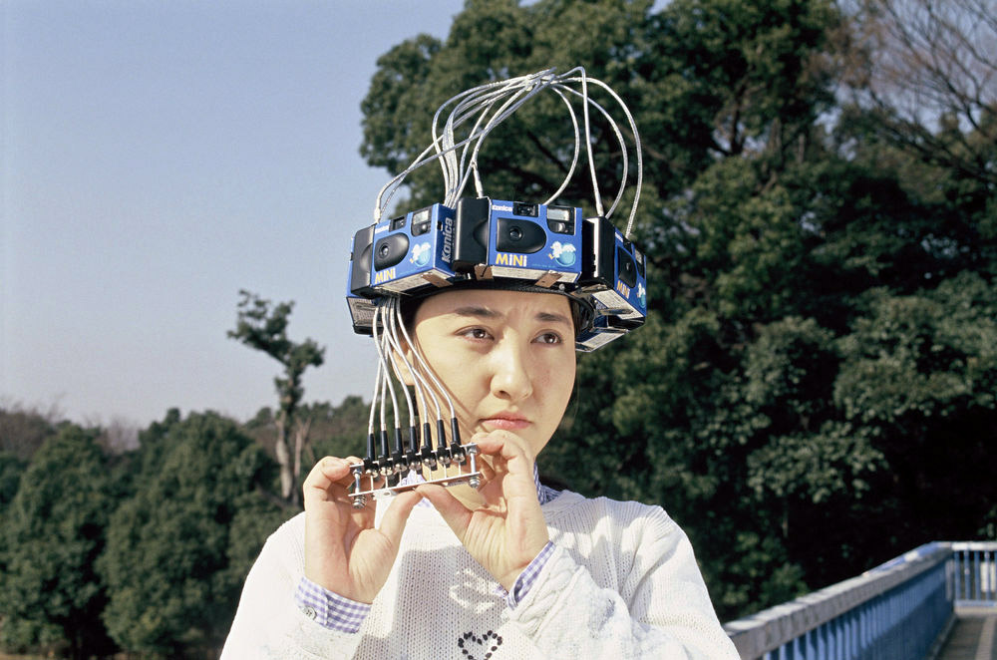

Slide 4
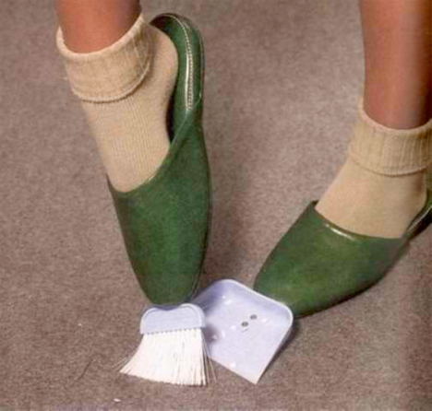

Slide 5
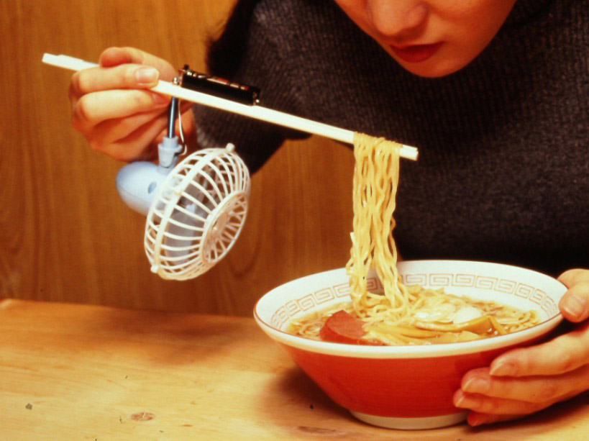

Slide 6
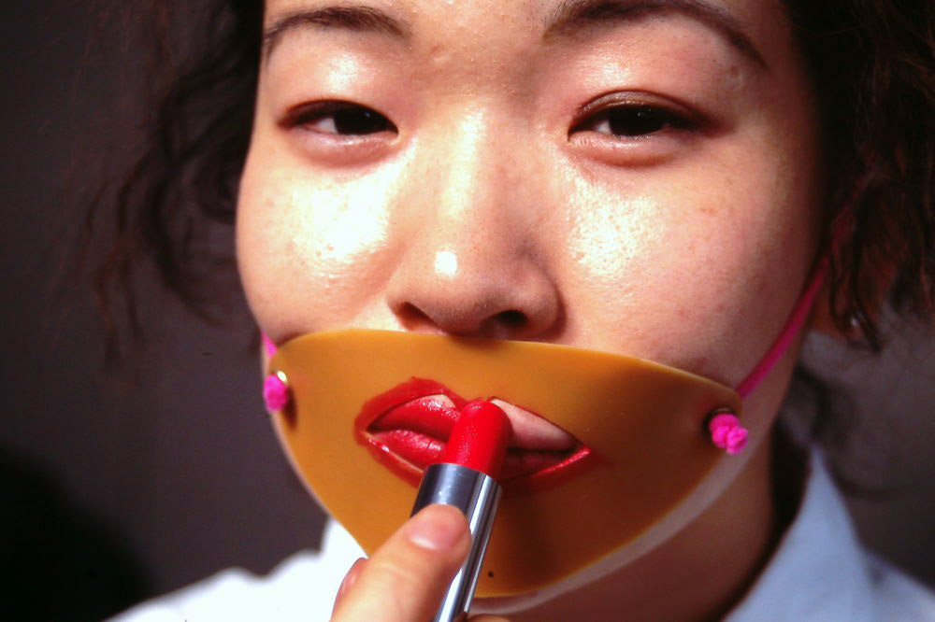

Slide 7
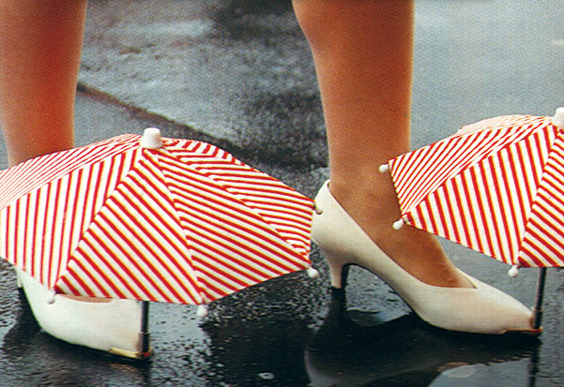

Slide 8
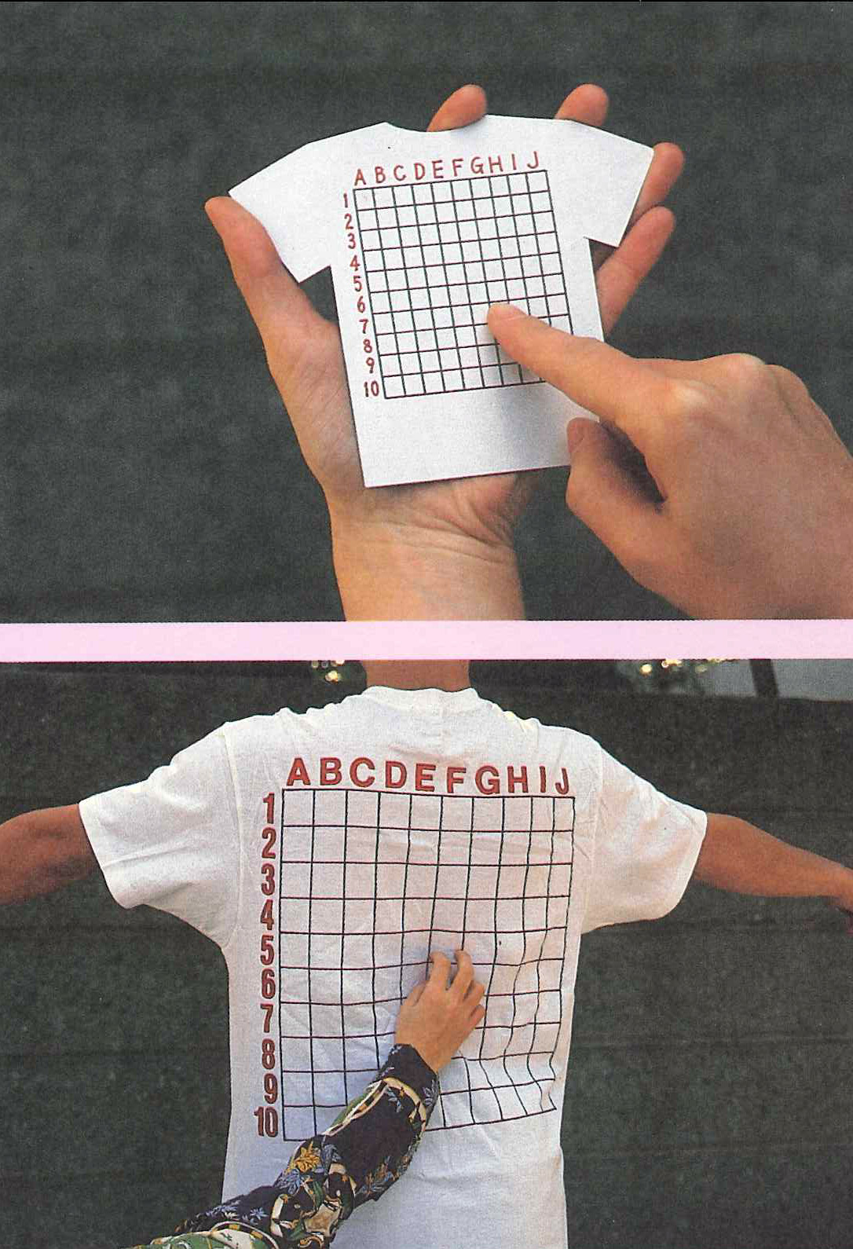

Slide 9
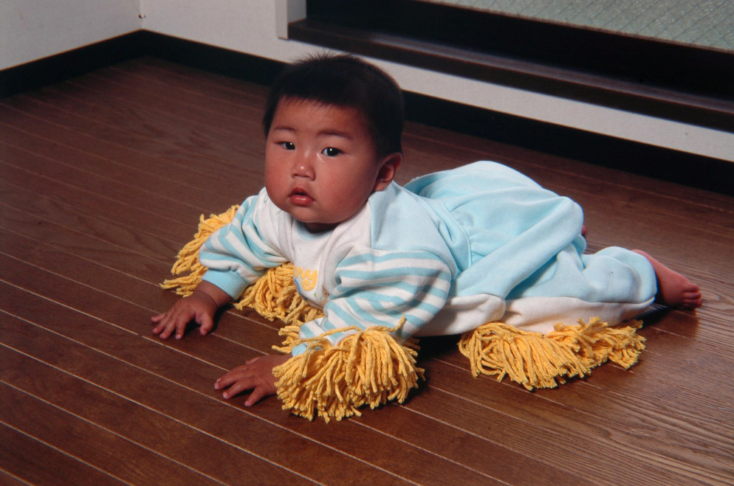

Slide 10
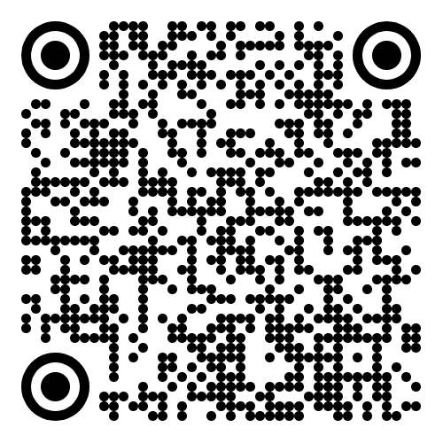
https://www.tofugu.com/japan/chindogu-japanese-inventions/

Slide 11
Hvad skal i lave idag?
I skal lave en app der følger de 10 designpunkter af Chindogu
Appen skal være skør/dum/fjollet/grim
Men den skal have god UI!!!
I skal også lave en præsentation på 5 minutter der viser jeres app og hvad den kan. I må gerne i præsentationen tilføje billeder fra ide generering, sketches, prototyper og andet der er relevant
Læg gerne appen på Github

Slide 12
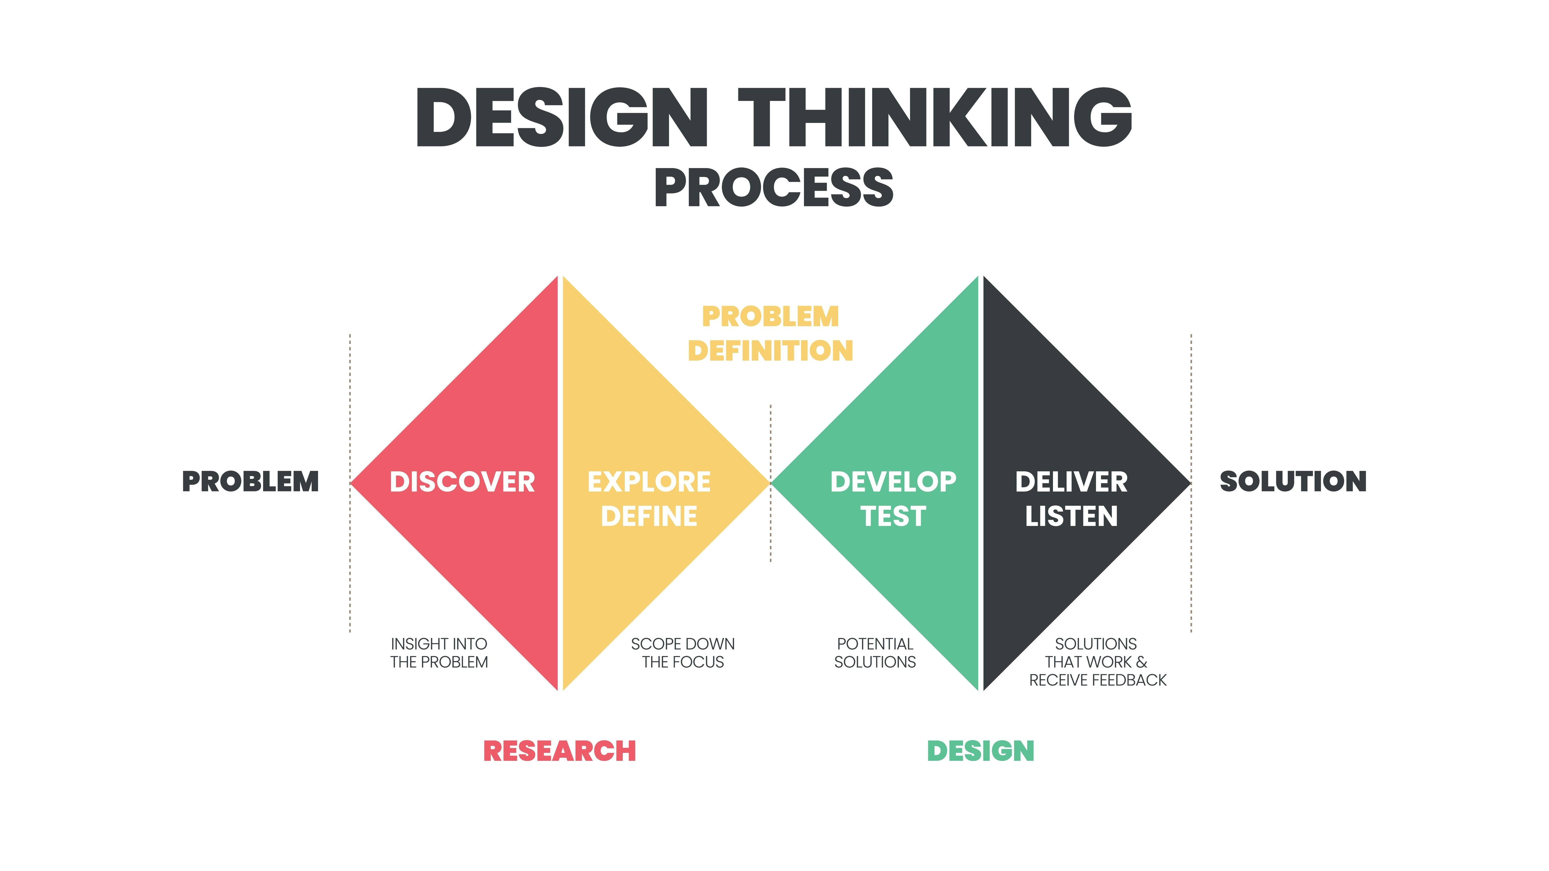

Slide 13

Plan
Introduktion af workshop og Chindogu
Start af jeres udviklingsprocess
15:00 - Presentations start
Luca Fusco (Værkstedsansvarlig I Maker Lab) will be the judge
15:45 - Kåring af vinder 🥇

Slide 14


